Slide 1
The World Telecommunication Standardization Assembly
(WTSA-12)
Fourth CTO Meeting
Dubai, UAE
18 November 2012
Malcolm Johnson, Director
Telecommunication Standardization Bureau, ITU

Slide 2

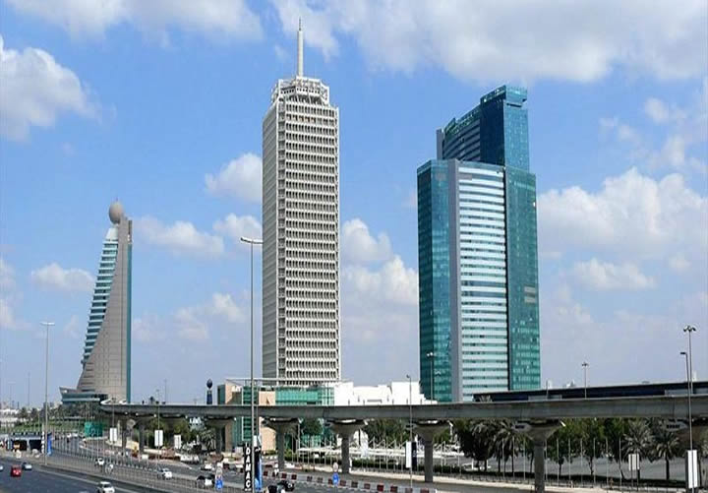
    World Telecommunication
    Standardization Assembly
    (WTSA-12)
    Dubai World Trade Centre, UAE
    20-29 November 2012

Slide 3
What is WTSA?
Sets direction, policy, structure for ITU-T
    Meets every four years
    Defines the general policy for the Sector
    Establishes ITU-T study groups
    Approves work program of study groups
    Appoints chairs and vice-chairs of study groups
    Reviews existing WTSA Resolutions (49)

Slide 4
Main objectives
    Underline ITU-T’s role as the most
    effective venue for international standardization
    Pick up new work on emerging technologies
    Increase efficiency in order to make best use
    of delegate time and resources
    Avoid duplication and overlap of work
    Increase participation and relevance

Slide 5
Stronger presence in certain areas
      e-Health
      Accessibility
      ICTs and climate change
      Internet of Things/M2M
      Intelligent Transport Systems
      Cybersecurity including Identity management
      IPTV, cloud computing and smart grid
      Conformity and interoperability

Slide 6
Who can participate?
    Member States, Sector Members and
    academia
    Observers:
      Regional telecom organizations
      Intergovernmental organizations operating satellite systems
      Any other regional or international organizations dealing with matters of interest
      UN and specialized agencies of UN and IAEA
    ITU elected officials in advisory capacity

Slide 7
WTSA Side Events and
Exhibition
Three Side Events:
  e-Health
  ICT innovation and standards
  Network resilience and disaster relief
Academia event
Showcasing
  Featuring state of the art technology meeting ITU-T standards

Slide 8
Candidatures
  Term limit=two terms
Objectives: to maintain level of
expertise and momentum
Expected results
      Nomination of capable chairmen
      Regional representation

Slide 9

Global Standards
Symposium
    Monday, 19 Nov 2012
    Intersection of the ICT sector with other vertical sectors such as health care, utilities, and transport
    Collaboration with other standards bodies
    Chairman will present conclusions to WTSA

